Slide 1




PRESENTED BY : SYED IBRAHIM
ADVANCED SQL PROJECT
PRESENTED BY: SYED IBRAHIM

Slide 2
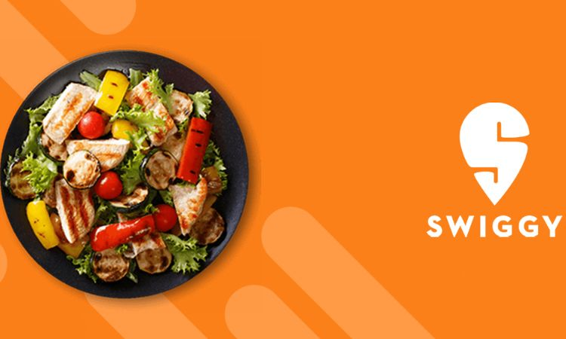
ABOUT SWIGGY
Swiggy is one of the largest and most popular online food delivery platforms in India, based in Bangalore. Over the years, Swiggy has transformed the food delivery landscape by offering a wide array of services that cater to customers, restaurants, and delivery partners. The platform provides a seamless experience by connecting users to their favorite local restaurants, making it easy to order food online and have it delivered to their doorsteps quickly and efficiently. Swiggy has grown into a household name by focusing on customer satisfaction, timely deliveries, and a broad selection of restaurants, ranging from local eateries to premium dining options.

Slide 3

Introduction
Swiggy is one of India's leading food delivery platforms, providing a wide range of services to customers, restaurants, and delivery partners. With a vast dataset containing information about customers, restaurants, orders, and delivery partners, Swiggy has the potential to uncover valuable insights through data analysis.
In this project, I explore the Swiggy dataset to provide business intelligence and enhance decision-making processes through SQL queries. By leveraging sophisticated SQL techniques, the goal is to analyze customer behavior, restaurant performance, and operational efficiency to support strategic initiatives.

Slide 4


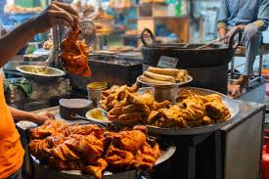
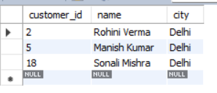
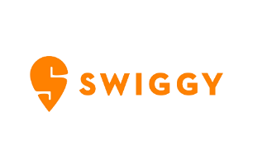
DISPLAY ALL CUSTOMERS WHO LIVE IN 'DELHI'.
SELECT CUSTOMER_ID,NAME,CITY
FROM CUSTOMERS
WHERE CITY= ”DELHI”
where city="delhi"

Slide 5

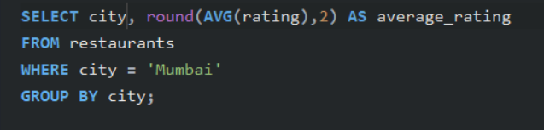
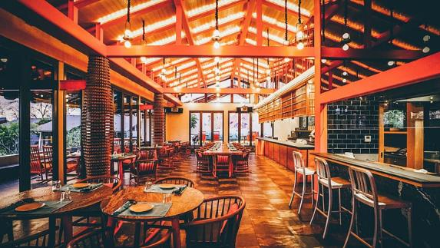

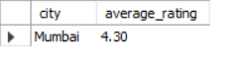
2. FIND THE AVERAGE RATING OF ALL RESTAURANTS IN 'MUMBAI

Slide 6


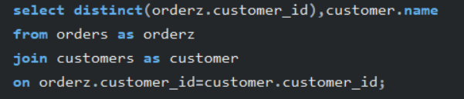
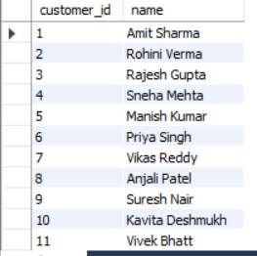
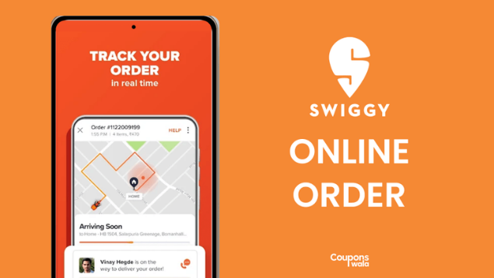
3. LIST ALL CUSTOMERS WHO HAVE PLACED AT LEAST ONE ORDER.

Slide 7

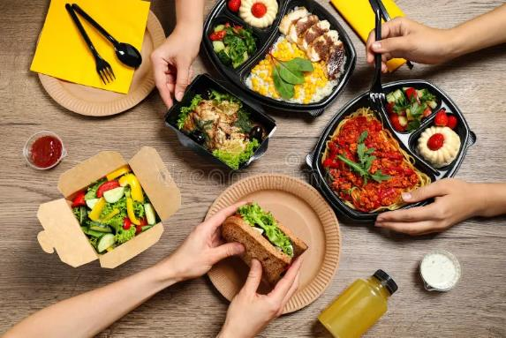
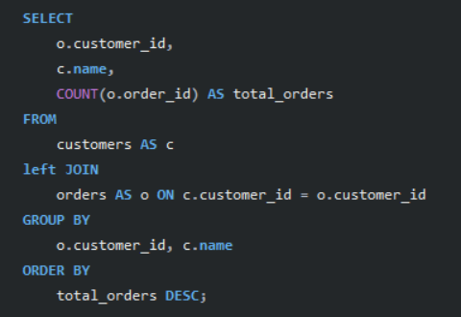
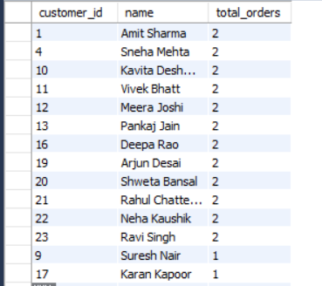
4. DISPLAY THE TOTAL NUMBER OF ORDERS PLACED BY EACH CUSTOMER

Slide 8


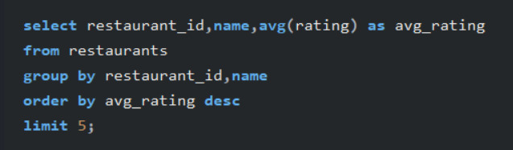

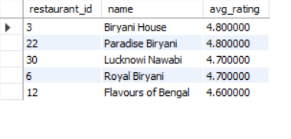

5. FIND THE TOP 5 RESTAURANTS WITH THE HIGHEST AVERAGE RATING.
hello@reallygreatsite.com

Slide 9


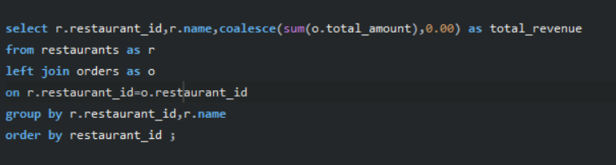

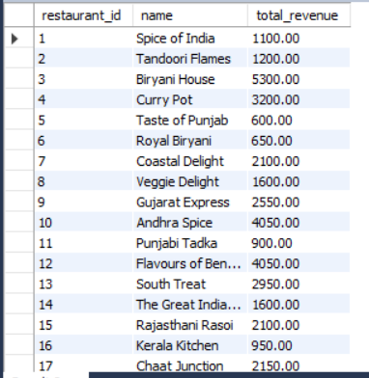
6. FIND THE TOTAL REVENUE GENERATED BY EACH RESTAURANT

Slide 10

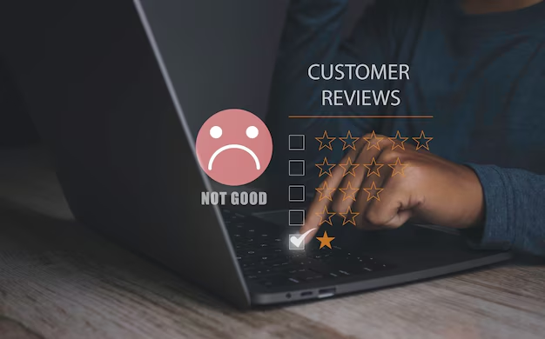
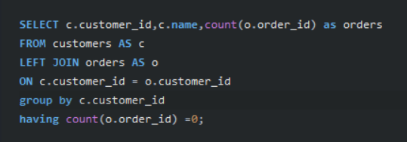
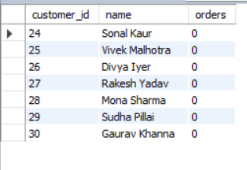
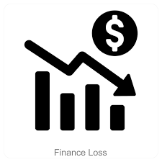
7. DISPLAY ALL CUSTOMERS WHO HAVE NEVER PLACED AN ORDER.

Slide 11


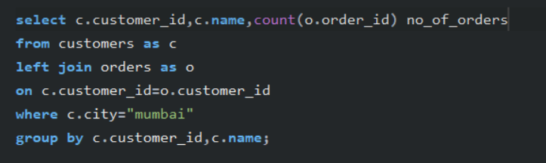
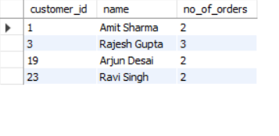
8. FIND THE NUMBER OF ORDERS PLACED BY EACH CUSTOMER IN 'MUMBAI'.

Slide 12
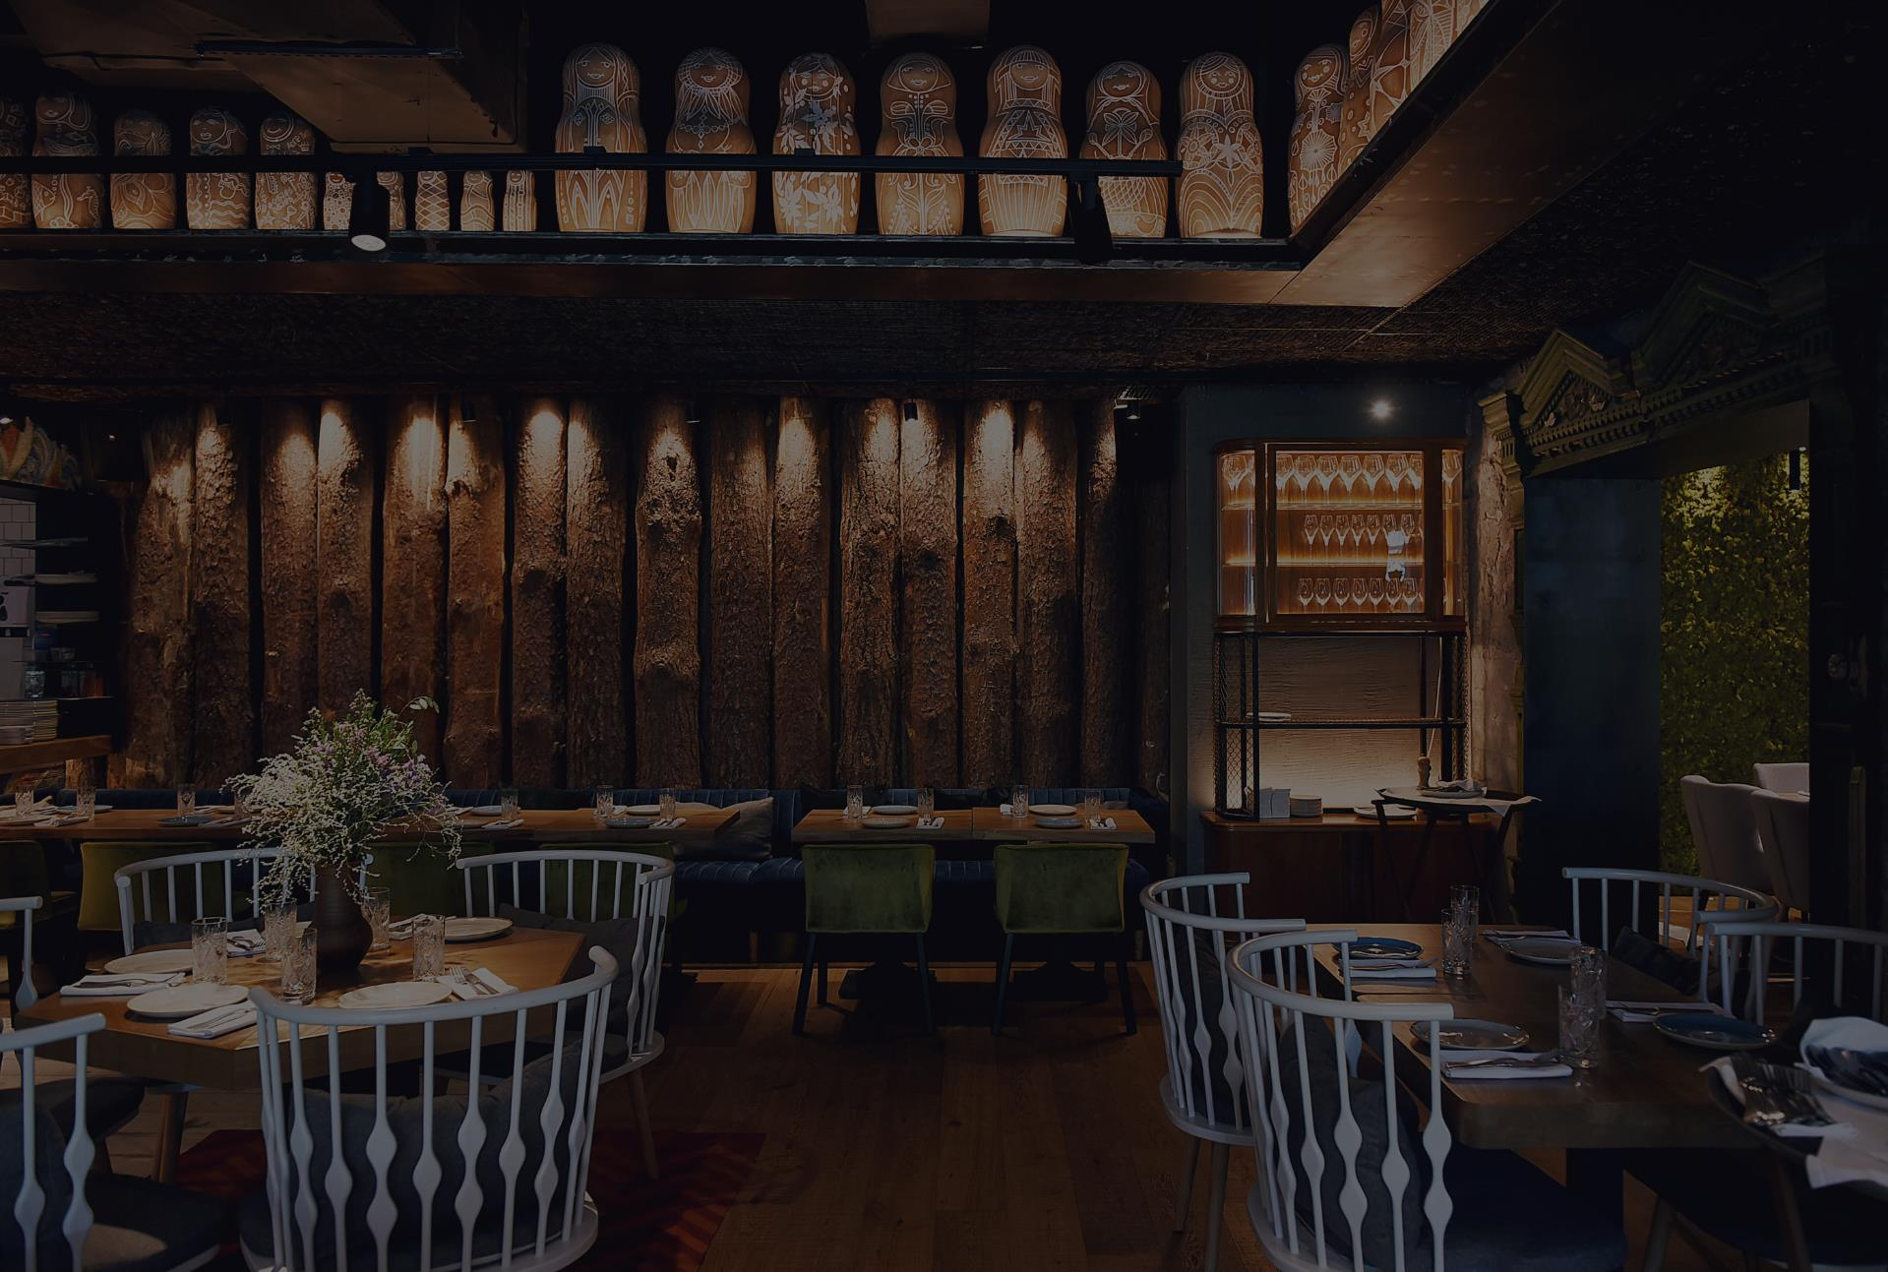

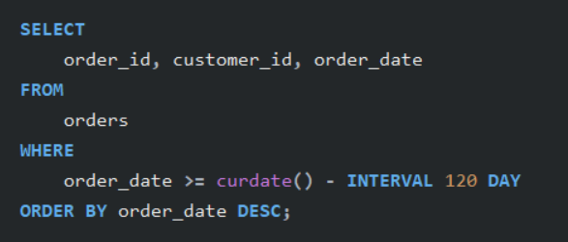
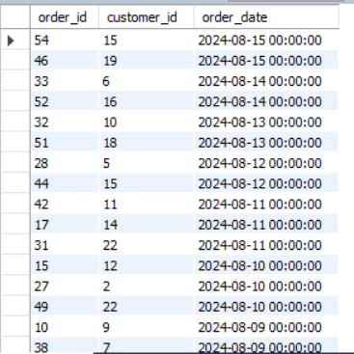
9. Display all orders placed in the last 120 days.

Slide 13
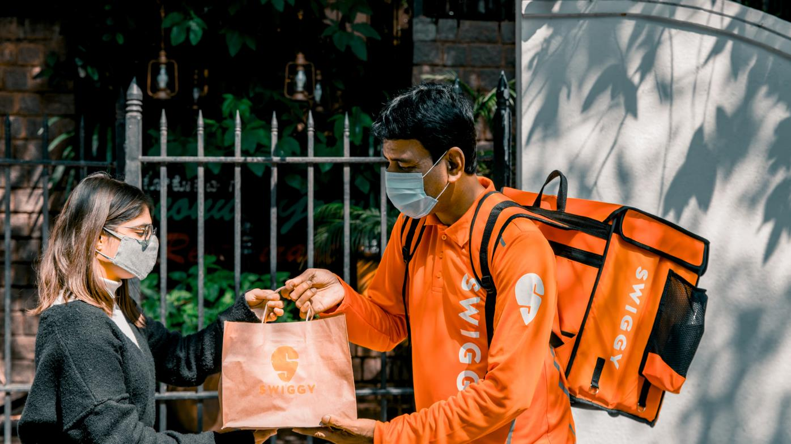


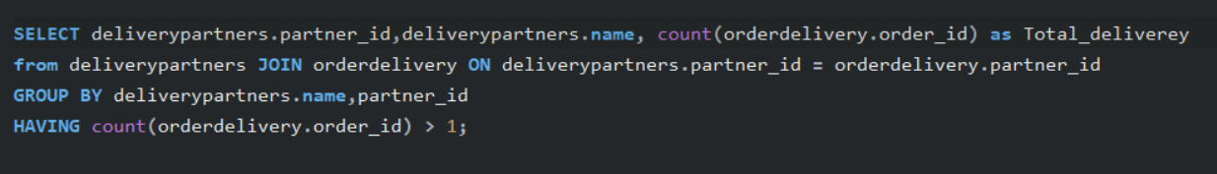
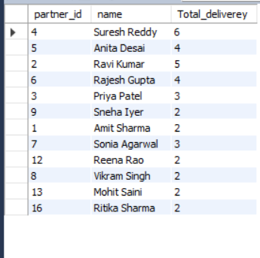
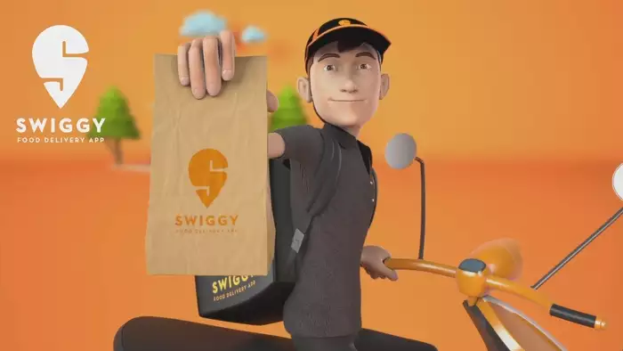
10. List all delivery partners who have completed more than 1 delivery

Slide 14

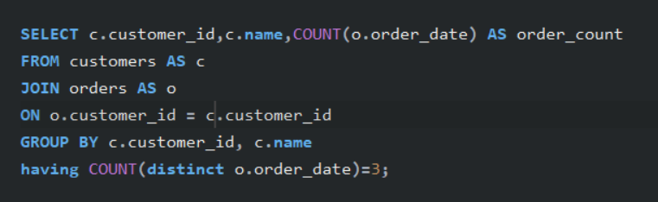
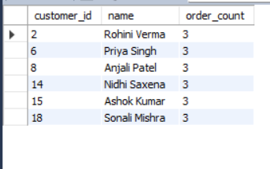
11. Find the customers who have placed orders on exactly three different days

Slide 15




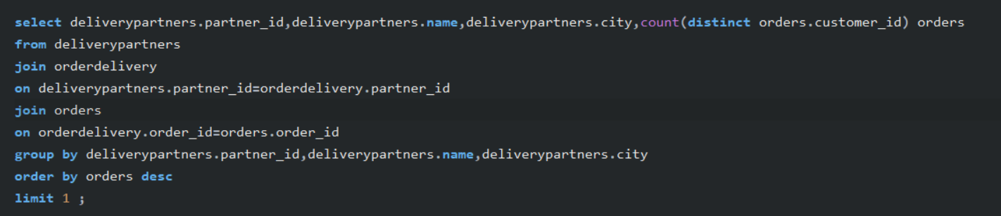
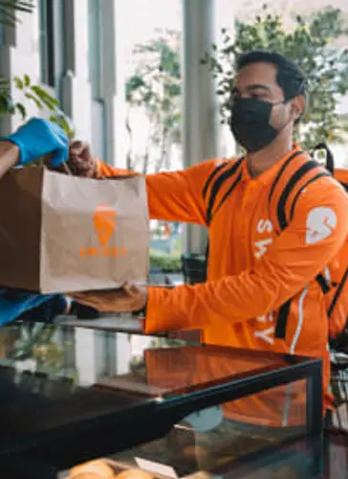

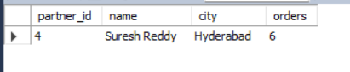
12. Find the delivery partner who has worked with the most different customers.

Slide 16


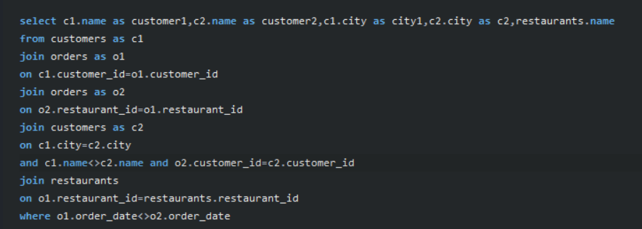
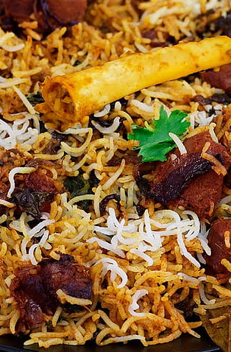

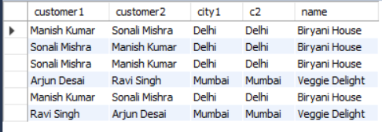
13. IDENTIFY CUSTOMERS WHO HAVE THE SAME CITY AND HAVE PLACED ORDERS AT THE SAME RESTAURANTS, BUT ON DIFFERENT DATES.

Slide 17


Insights and Analysis:
Customer Insights: By identifying which customers have placed multiple orders, we can target them for loyalty programs or personalized promotions.
Restaurant Performance: Analyzing the total revenue and average ratings allows us to gauge restaurant performance and determine which restaurants might need more attention or marketing.
Delivery Partner Efficiency: Understanding the number of deliveries and which partners are most efficient can optimize delivery logistics.
Order Patterns: Analyzing order frequency and patterns (e.g., customers ordering on specific days) can guide promotional efforts and marketing strategies.
Geographic Insights:
Analyzing orders by city reveals regional preferences, demand trends, and
opportunities for targeted promotions and delivery zone optimization.
PRESENTED BY: SYED IBRAHIM

Slide 18
Conclusion
This project demonstrates the importance of SQL in gaining actionable insights from a swiggy dataset. By leveraging complex queries with joins and aggregation, we were able to answer key business questions related to customers, restaurants, orders, and delivery partners. This analysis can support Swiggy's strategic decision-making process, helping them to enhance customer engagement, improve restaurant partnerships, and optimize delivery operations.
PRESENTED BY: SYED IBRAHIM

Slide 19

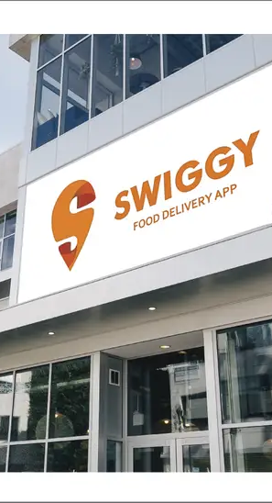




THANK YOU !
contact me
social
Mail
syedibrahim7659@gmail.com
syed ibrahim

